Slide 1
Affiliated Societies Meeting HKUST Students’ Union 2015-2016

Slide 2
Agenda
Introduction
Report of Orientation Affairs
Green! O Camp Project
Important dates for O Camp documents’ submission
Q&A session

Slide 3
Introduction
Provisional Orientation Affairs Committee (POAC)
Chairperson | WONG, Ka Wun Karen (Council Vice Chairperson)
Mobile | 64840350
ITSC | kwkwongaa

Slide 4
Orientation Affairs

Slide 5
POAC Formation
The Provisional Orientation Affairs Committee shall consist of the following members:
Details | Position/ Representative
Council Vice Chairperson | Chairperson
One Representative from PEXCO | Secretary
One Representative from EB | EB
Two Representatives from House Association | HOUSE
Two Representatives from ICA | ICA
One Representative from IP | IP
Two Representatives from SA | SA
Two Representatives from SBM | SBM
Two Representatives from SENG | SENG
One Representative from SHSS | SHSS
Two Representatives from SSCI | SSCI

Slide 6
POAC Formation
The Provisional Orientation Affairs Committee shall take charge and be responsible for of all orientation affairs of the Union. “Orientation Affairs” shall include matters and programmes concerning Registration Day, Orientation Days, Orientation Camps and Orientation Weeks.

Slide 7
POAC Formation
Name | Position/ Representative | Tel
WONG Ka Wun Karen | Chairperson | 6484 0350
CHIU Chee Wah Gloria | Secretary | 6603 6670
CHAN Ince Hong To | EB | 5408 0168
CHAN Pak Long | HOUSE | 6479 1107
CHONG Kwan Lok | HOUSE | 6828 1941
CHEUNG Wing Hong | ICA | 6501 3322
WONG Yeung Hoi | ICA | 9616 0748
CHAN Lai Kit, Sam | IP | 9552 4187
LAM Man Tsi | SA | 6254 5825
LIN Hung Hing | SA | 5137 2073
TAM Cho Him | SBM | 6901 1223
LEE Ho Wang | SBM | 6081 2687
CHOW Ho Wa John | SENG | 9473 7443
SZE Chi Lik | SENG | 6232 6300
LAM Tsz Fung Jeffrey | SSCI | 9767 4177
LEUNG Chun Yee Justin | SSCI | 6346 6220
TSANG Lena | SHSS | 6178 3675

Slide 8
Period of the Registration Day and Orientation Camp
Orientation Camp Counter Period :
Registration Day: 12 August 2015
School talk (SENG, SSCI, SBM): 13 August 2015
Back up day: 14 August 2015
Location :
12 Aug: Sports Hall & LG1 (Counter), Atrium (Promotion)
13 Aug: Atrium & Concourse (Counter & Promotion)

Slide 9
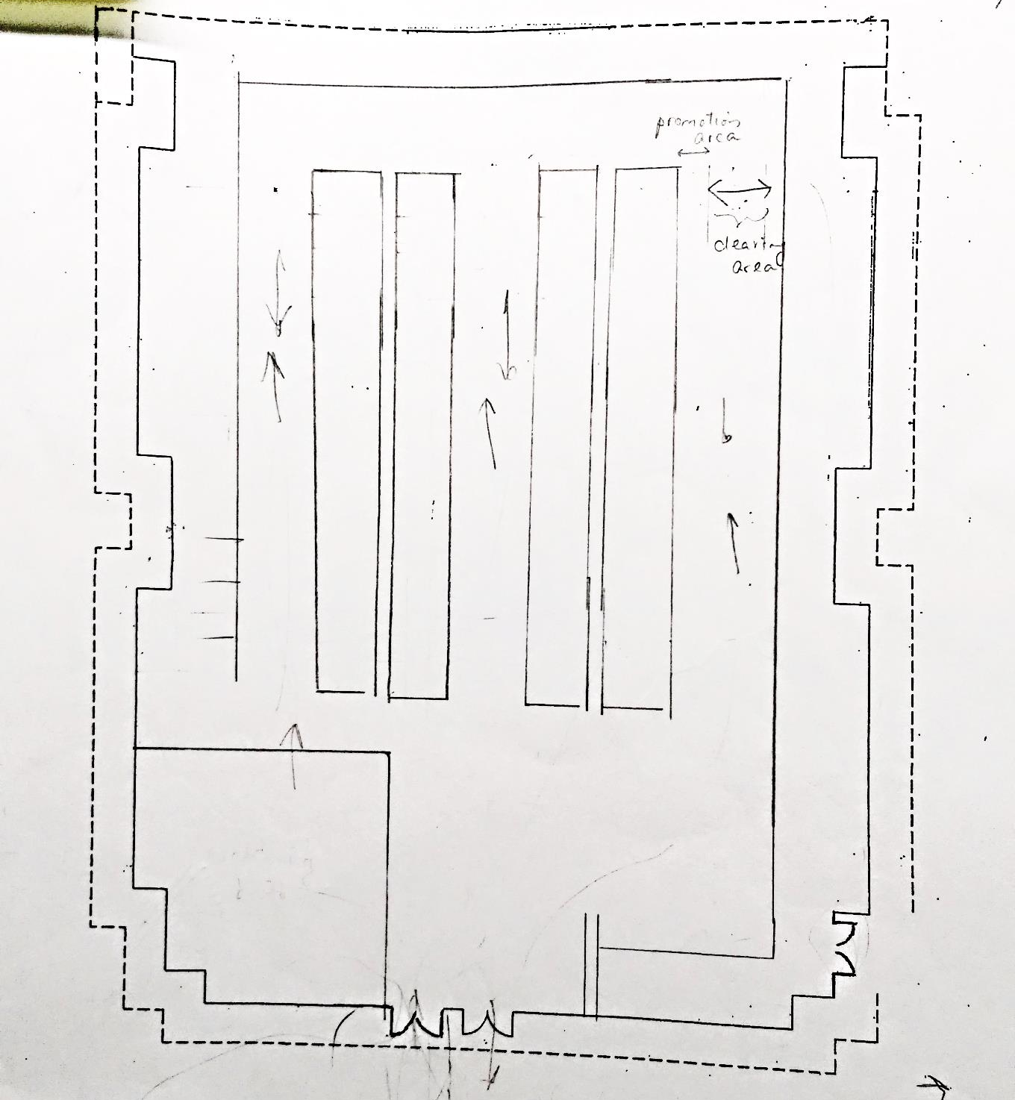
Counter Area
School Welcoming booth
Proposed Floor Plan for 12 August 2015 @ Sports Hall (not confirmed)

Slide 10
Counter Area
School Welcoming Booth
@ Student Lounge
Alternative: Floor Plan (2) for 12 August 2015 @ Sports Hall (not confirmed)

Slide 11
Period of the Registration Day and Orientation Camp
Orientation Camp Period:
15 - 26 August 2015
Time slot | Date
1st Session | 15 Aug – 17 Aug
2nd Session | 17 Aug – 19 Aug
3rd Session | 19 Aug – 21 Aug
4th Session | 21 Aug – 23 Aug
5th Session | 23 Aug – 26 Aug

Slide 12
Non-local participants in O Camp
Non-local arrival: 19 August 2015
Can only join time slot 3rd – 5th session

Slide 13
Hall Places arrangement
Available Bed Spaces :
UG Halls | UG I | UG II | UG IV | PG Hall II | UG VI
Bed spaces | 260 | 200 | 257 | 190+48* | 252
* Available after 16 August 2015
1st Session: 1, 159
2nd – 5th Session: 1207
UG Hall III – renovation works
Exchange students check-in on 27 August morning
Mass check-in on 28 August
Notes:
28 Mass check-in

Slide 14
Hall Places arrangement
Hall Charges :
 | Per Room per night
Twin-bed room | $ 127
Triple room | $ 139
Bunk-bed room | $ 109
Notes:
1030 前firm 到hall charges

Slide 15
Time allocation for O Camp
Duration | Number of time slot
3 Days 2 Nights | 4
4 Days 3 Nights | 1
Total | 5
Submission deadline for O Camp Proposals
via email su_union@ust.hk
(include activity details, venue & equipment):
16 June 2015 (TUE)
http://su.ust.hk/OACFiles.html

Slide 16
Non-Jupas Registration Day
Registration Day: 15 July & 22 July
Promotion Area: Atrium (around 20 counters per day)
Submission deadline for Atrium Booking form
19 June 2015 (FRI) before 12:00
to FMO

Slide 17
Venue List
Student Amenities
LG4 Common Rooms 1+2
LG4 Common Room 3
LG5 Common Room 7
LG5 Multi-Function Room
LG5 Conference Room
Hall II Common Room 4
Hall VI Common rooms 5+6
5 Meeting rooms (#1, 2, 3, 4 and 7)
BBQ sites (#B, C, D and #1-5)

Slide 18
Venue List
Sports Facilities
LG1 Badminton Court (Sports Hall)
LG1 Basketball Court (Sports Hall)
LG1 1027
LG1 1031
LG4 4204
Artificial Soccer Pitch
Mini Soccer Pitch
Seafront Basketball Court
Lawn Area (Phase 3)

Slide 19
Venue List
Other communal Areas
Atrium
Application with event proposal is required for booking of Atrium from 12:45 to 14:00 (can use Sound equipment)
Campfire after 19:00
G/F Art Hall
Lecture Theater and & Classrooms (TBA by ARRO)

Slide 20
Equipment List
A11 | DVD Player | DVD影碟機
C1 | Portable P. A. System/Recorder with Cassette Deck | 手提擴音接收器
C2 | Portable Mega Phone | 手提擴音器（大聲公）
D1 | Mic with Cable | 有線咪高風
E1 | Table Mic Stand | 座檯式咪架
E2 | Floor Mic Stand | 座地式咪架
F1 | Projection Screen | 投射銀幕
F2 | 50" Projection Screen (small size) | 50吋投射銀幕（小型）
G3 | Video Projector | 影視投射器
H2 | Power Speaker Set (for Atrium only) | 重量級揚聲器組合（只供大堂使用）
H3 | Speaker with Built-in Amplifier | 擴音揚聲器
M1 | Folding Type Table | 可摺式摺檯
M2 | PVC Chair | 膠椅
M3 | Notice Board 4' x 6' | 告示版
M8 | Stand Riser | 合唱團台階
M10 | Sand Bag | 沙包
N1 | Extension Cable Reel | 拖板連插蘇座
O1 | Line-up Stand | 排隊圍杆
Q1 | Walkie-talkie | 對講機
S1 | Mobile Stage | 流動舞台板

Slide 21
O Camp Deposit
A deposit of $1000 has to be made if societies would like to borrow any equipment from the University.
Please deposit the money into the HKUSTSU bank account (Hang Seng Bank 361-047681-004) and submit the receipt to LG5 Students’ Union Office before 30 June 2015.
NO CASH!!

Slide 22
O Camp Information for the First Year Success (FYS) website
Each society must send the following information via email su_union@ust.hk by 23 June 2015
Name of Organizer: e.g. HKUST Student Union
Information of the Person-in-charge (max. 2)
i. Name in English
ii. Contact (Mobile and ITSC email account)
3. Society Website URL (if any)
4. O Camp Period (Date & Time)
5. O Camp Venue (HKUST campus or off-campus venue)
6. O Camp Quota

Slide 23
Use of E-Board to promote O Camp
A maximum of 3 posters per society, each poster maximum 15 seconds for a posting period of maximum 2 weeks (request for further extension)
Email content: NAME of society, PIC contact and posting period
Resolution: 1920 X 1000 pixels
Poster file format: JPG/ JPEG
The proposed E-Board slides must be sent to PAO by email eboard@ust.hk two weeks prior to the first day of the posting period through society email account.
Notes:
PAO E-Board Sam 23586309

Slide 24
Student Activities Insurance Scheme
Insurance provided by SAO for Alumni / non-HKUST people who involve as O Camp helpers, invited guests or working team members in activities
This year: Free of charge
Due date: 1 day before the start of your O Camp
https://sao.ust.hk/studentlife/insurance_for_nonHKUST_persons_involved.html

Slide 25
Green! O Camp Project

Slide 26
Important dates for O Camp documents’ submission to SU
Deadline | Document
16 June 2015 (Tue) | O Camp Proposal *(submit to su_union@ust.hk)
19 June 2015 (Fri) | Non-Ju: Atrium Booking form to FMO
19 June 2015 : 2nd POAC Meeting (to confirm time slot)
23 June 2015 (Tue) | O Camp information for FYS website *(submit to su_union@ust.hk)
 | Venue list booking chart
 | Hall place allocation of each field
26 June 2015 (Fri) | Equipment list booking chart
30 June 2015 (Tue) | O Camp deposit receipt

Slide 27
Q&A

Slide 28
Contact
SU Office
Location: LG 5313
Tel: 2335 1732
Email: su_union@ust.hk
SU Council Office
Location: LG 5312
Tel: 3521 1599
Email: su_ucoun@ust.hk

