Slide 1
6th Society Meeting
29th January 2016

Slide 2
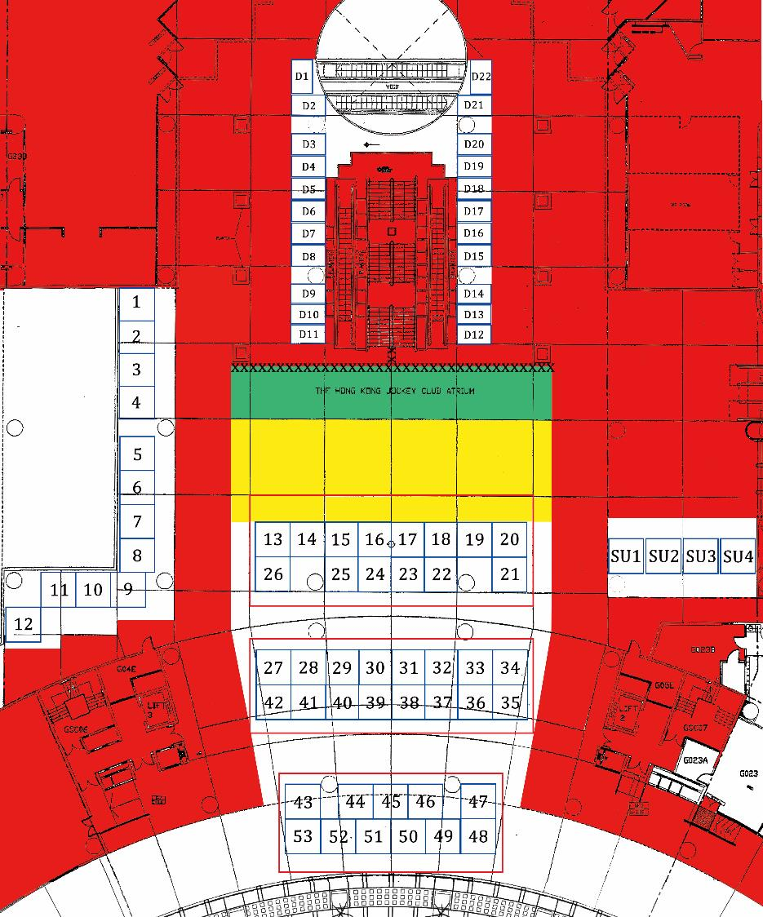
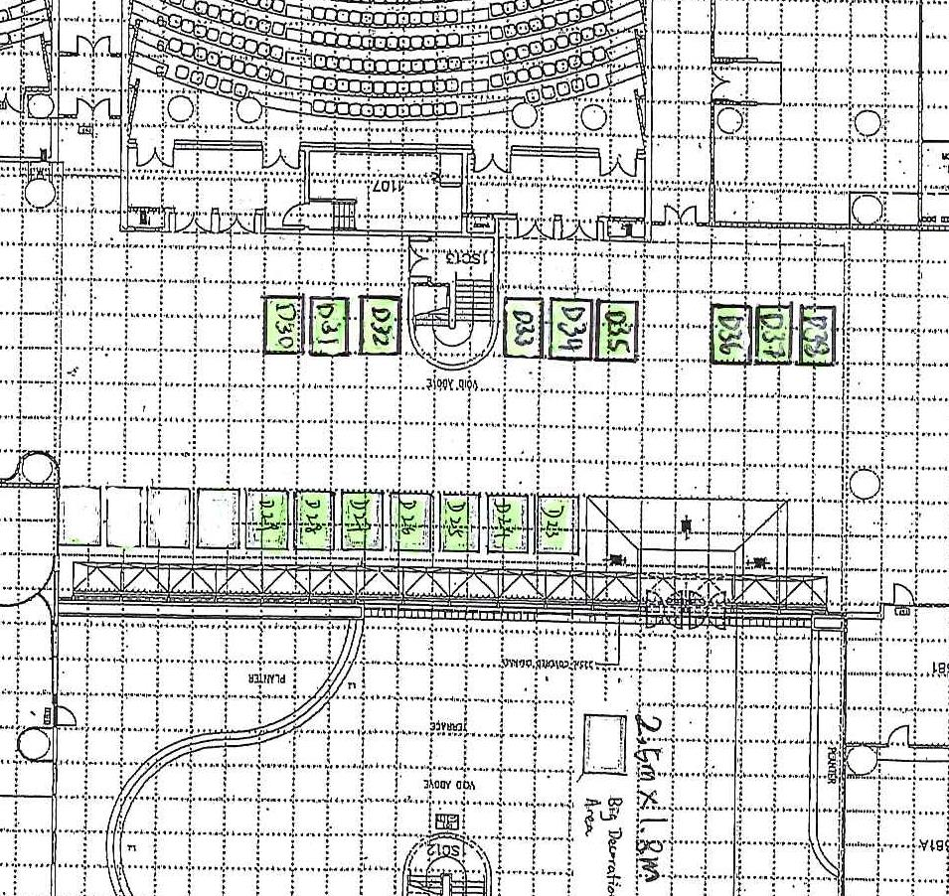

Slide 3
Counters & Big Decorations
Set up can be done from 17:00 every Sunday
Get specific cable tie from SU after set-up of counters

Slide 4
CNY Arrangement
Remove ALL promotion items on 5th February 2016 by 22:00
Big decorations shall be stored at LG2 multi-storey car park (9pm-10pm)

Slide 5
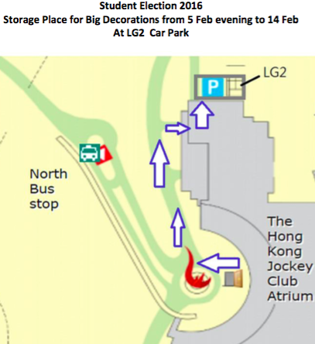
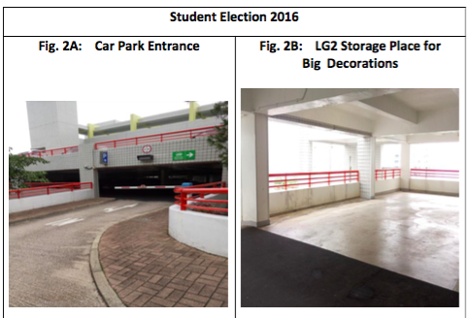
CNY Arrangement

Slide 6
Chanting
Only members of nominated cabinets shall be allowed to chant
Flags
MUST NOT EXCEED 3m (H) x 2(m)
MUST be held by at least 2 people at all times
MUST be placed at designated area behind East Asian Bank when not being use

Slide 7
Statement of Understanding
Electricity are used for the charging of cellular communication devices and computing devices only
In the event of violation of the abovementioned, power supply in Atrium are to be cut off with immediate effect for the rest of Promotion Period 2016 and may affect the usage right of electricity in future events.

Slide 8
Statement of Understanding
Terms and regulation on Flag:
Overall size of flag must not exceed 3m (H) x 2m (W)
The following penalties shall be given to nominated cabinet(s) in an accumulative basis for any violations of this regulation or failures to follow instructions given by authorised persons-in-charge:
1st time: Verbal warning with record
2nd time: Prohibited from chanting activities for the rest of Promotion Period 2016
3rd time: Prohibited from all promotion activities for the rest of Promotion Period 2016
4th time:Prohibited from participation in Promotion Period 2017

Slide 9
Statement of Understanding
The following penalties shall be given to nominated cabinet(s) on an accumulative basis for any serious and repeated violations of this regulation or failures to follow instructions given by authorised persons-in-charge:
1st time: Verbal warning with record
2nd time: Prohibited from promotion activities on the following promotion day
3rd time: Prohibited from all promotion activities for the rest of Promotion Period 2016
4th time: Suspension of booking rights from three to six months as deemed appropriate

Slide 10
Contact
LG5 Students’ Union Office Gloria Chiu
Tel: 2335 1732
Email: su_union@ust.hk

