Slide 1
The 3rd Affiliated Societies Meeting
HKUSTSU, 2016-2017
28 December 2016

Slide 2
Agenda
Introduction
Briefing on collection of materials on the last day of Hong Kong Brands and Products Expo 2016 (2 Jan 2017)
Arrangement of Promotion Period 2017
Q&A

Slide 3
Introduction
CHEUNG Wing Hong Kelvin (KC)
Vice-President (Internal), Executive Committee, HKUSTSU, 24th Session
ITSC: whcheungah
HO Wing Hang Jasmine
Internal Secretary, Executive Committee, HKUSTSU, 24th Session
ITSC: whhoac

Slide 4
Collection of materials on the last day of Hong Kong Brands and Products Expo 2016(工展會)
Date: 2nd January, 2017 (Monday)
Time: 12:00pm-3:00pm, 2:00pm-5:00pm, 3:00pm-6:00pm
Venue: Hong Kong Victoria Park

Slide 5
Floor plans of Hong Kong Brands and Products Expo 2016

Slide 6
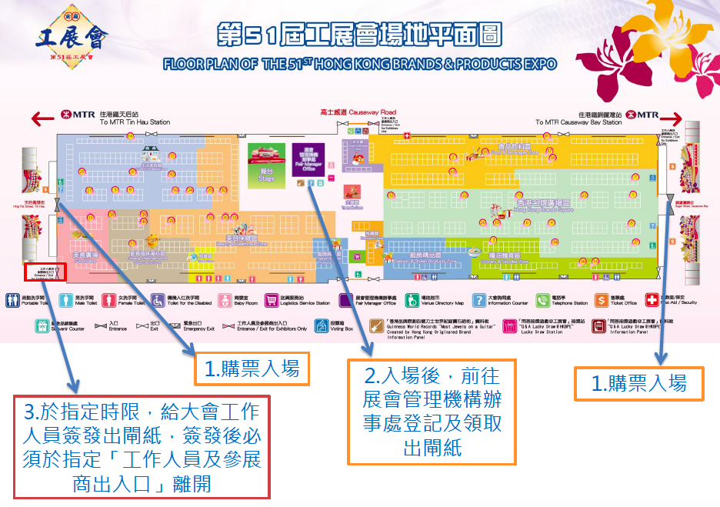

Slide 7
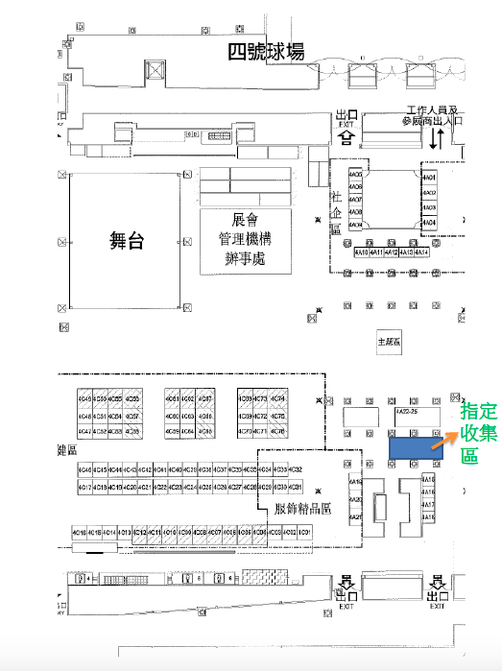

Slide 10
Reminders
ONLY cardboard(紙皮) and foam board(珍珠板) are allowed to be collected
Other products (e.g. sponsors) are NOT allowed to be collected to avoid misunderstandings, even with the agreement of exhibitors
Remember to look for transportation in advance to move the materials out from Victoria Park

Slide 11
Reminders (con’d)
Materials are only allowed to be moved out within the time period, i.e. before 3:00pm, 5:00pm and 6:00pm
The earliest time of collection is 12:00pm
Remember to bring your society’s chop for registration

Slide 12
Arrangement of Promotion Period 2017 (All details are under discussion with SAO and FMO)
Aim: Provide an opportunity for nominated cabinets to promote themselves
Duration: 1st – 21st February, 2017 (15 days)
Polling: 22nd – 24th February, 2017 (3 days)

Slide 14
Counter
Horizontal setting 橫排
Allocation method:
-Auction/Competitive bidding
-All nominated cabinets who wish to participate in ProP 2017 are eligible to participate in the auction
-No cash payments need to be paid once the transaction is deal
-Societies are required to sign an agreement with society’s chop
-Payments have to be paid if violations in rules and regulations throughout the whole Promotion Period, or else no payment is needed

Slide 15
Counter (con’d)
-Societies are required to sign an agreement with society’s chop
-Payments have to be paid if violations in rules and regulations throughout the whole Promotion Period, or else no payment is needed
-The auction will determine the ONE counter arrangement for the whole Promotion Period, i.e. no change in counters is needed

Slide 16
Big Decorations
Allocation method:
Draw lots with swapping
Height: To be discussed

Slide 17
Banner
Allocation method:
Draw lots with swapping
More banner spaces will be added in Promotion Period 2017 in 4/F, more details will be provided in the short future

Slide 18
Chanting
One session: Every day 1:00pm-2:00pm
Venue: Piazza
Exact location of chanting will be announced later after measurement and discussion with SAO and FMO

Slide 19
Applications for Assignments
Deadline: 9th January, 2017 (Monday) 5:00pm
BOTH online google form and hard copy to LG5 SU office (Miss Flora Tang) are required to be submitted in order to make a valid application
Email with the required links and documents will be sent out after today’s society meeting

Slide 20
Temporary Storage and Preparation Space for nominated cabinets
Duration: 4th-26th January, 2017
Common Room 5+6, Common Room 4, Common Room 7, Area outside LG5 Student Amenities
Send an email to sairisliu@ust.hk for application of spaces on or before 29th December, 2016
Please refer to the email forwarded to you on 23rd December, 2016 for more details

Slide 21
SU membership
According to the Constitution of HKUST Students’ Union Article 16.2,
‘Only Full Members of the Students’ Union shall be eligible for being Full Members or office bearers of affiliated societies.’
Please refer to the following procedures if members of nominated cabinets members are NOT YET a full member of Students’ Union:

Slide 25
Official email accounts for nominated cabinets
Should have received an email sent by HKUST Students’ Union about official email accounts for nominated cabinets on 6th December, 2016
Format: XXXnomcab@hkustsu.hk
ALL communications between nominated cabinets and SU MUST be made through this official email account (including general enquiries, swapping of assignments, etc.)
Emails written from other non-official accounts WILL NOT be replied by us
Election Board please pass the email account to your nominated cabinets before 1st January 2017
Please send an email to su_union@connect.ust.hk for request of resetting password

Slide 26
Q&A

Slide 27
Contact
General enquiries:
su_union@connect.ust.hk
Office hours: LG5313 Miss Flora Tang
KC
Vice-President (Internal)
Email: kc@hkustsu.hk
Tel: 65013322
Jasmine
Internal Secretary
Email: jasminehwh@hkustsu.hk
Tel: 94067124

